Slide 1
AI IN FINANCIAL SERVICES
DEFECT DETECTION FOR LAPTOPS
Industry Mentor
Manu Sharma
Hewlett Packard Enterprise(HPE)
Gayathri R 22i218
Vinithaa P 22z273
Kiruthika Sermadurai 22z336
Sanjitha R 22z259
Durga G 22z321
Academic Mentor
Dr.Suriya S
CSE Department
PSG College of Technology

Slide 2
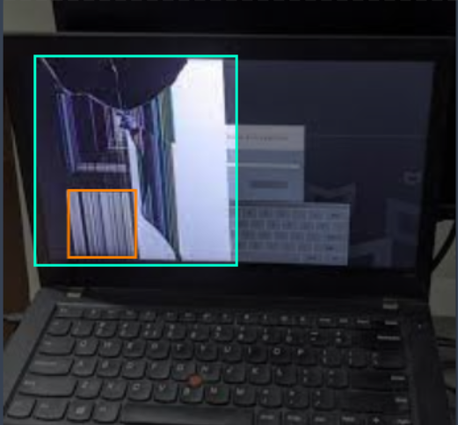
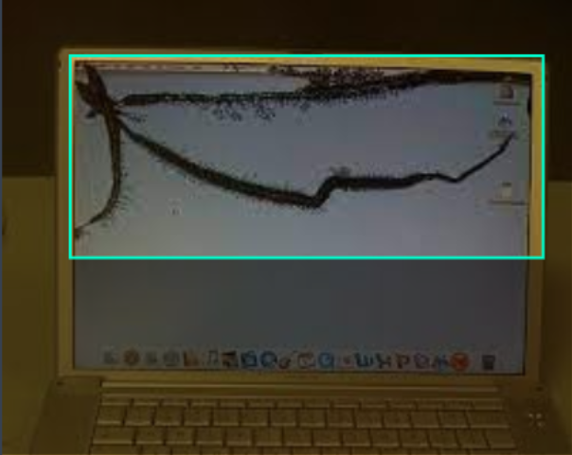
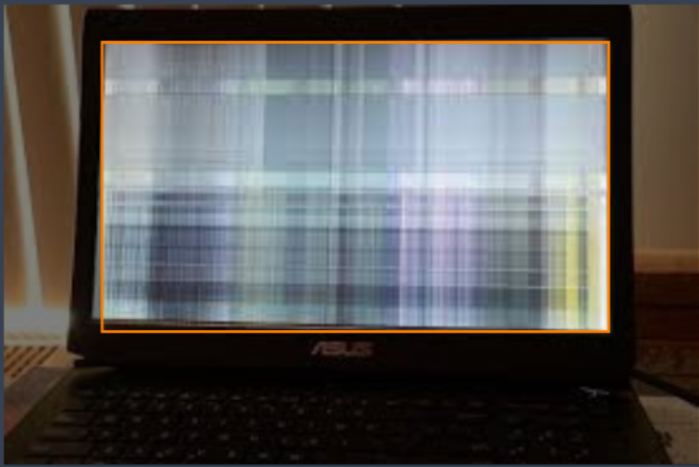
DATASET LINK:
https://universe.roboflow.com/team-ks/broken-laptop-parts/images/

Slide 3
PREPROCESSING AND AUGMENTATION STEPS:
Data Collection
Gather images of laptops, servers, and storage devices (both defective & non-defective).
Ensure a balanced dataset covering different brands, angles, and lighting conditions.
Data Cleaning
Remove duplicate or irrelevant images.
Convert images to a uniform format (e.g., .jpg, .png).

Slide 4
PREPROCESSING AND AUGMENTATION STEPS:
Resizing & Normalization
Resize all images to a fixed dimension (e.g., 224x224).
Normalize pixel values (0-1 by dividing by 255).
Geometric Transformations (For Robustness)
Rotation (±15° to ±30°) – Helps recognize defects from different angles.
Translation (±10% Width/Height Shift) – Simulates object misalignment.
Zoom-in (5-15%) & Zoom-out (5-10%) – Covers varying distances.
Lighting & Color Adjustments (For Environment Variations)
Brightness Adjustment (±20%) – Adapts to different lighting conditions.
Contrast Variation (±15%) – Helps detect defects under varying contrast.

Slide 5
QUERIES:
How many images are available? Do we have a balanced number of defective and non-defective samples?
Do we have metadata for each image ?
What are the preprocessing and augmentation steps expected?

Slide 6
Literature Survey
Dataset from kaggle that has images of laptops:
https://www.kaggle.com/datasets/sugxm00/laptop-dataset
Defect Prediction for New Products During the Development Phase
https://asmedigitalcollection.asme.org/testingevaluation/article-abstract/42/4/989/1190142/Defect-Prediction-for-New-Products-During-the?redirectedFrom=fulltext
Defect detection of laptop appearance
https://www.niclab.ac.cn/assets/pdf/2023-Defect%20Detection%20of%20Laptop%20Appearance%20Based%20on%20Improved%20Multi-Scale%20Normalizing%20Flows.pdf

Slide 7
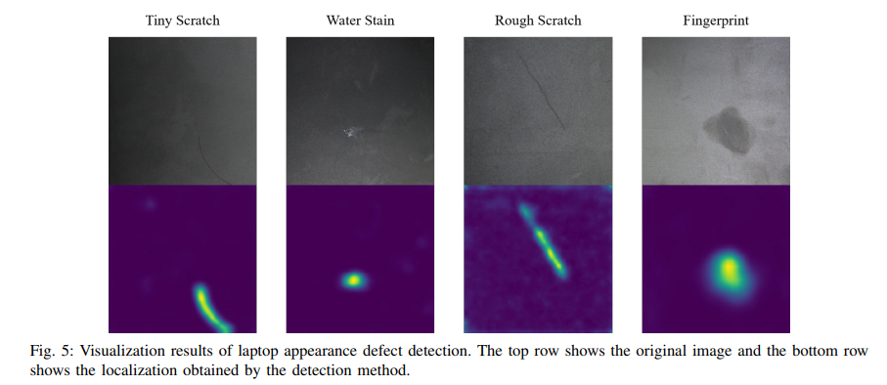

Slide 8
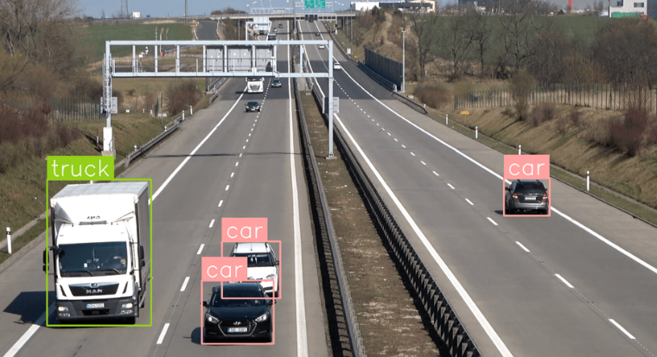
YOLOv8
YOLOv8 (You Only Look Once version 8) is an advanced real-time object detection model developed by Ultralytics.
It directly predicts bounding boxes and class labels in a single pass through the neural network.
Reasons to use YOLOv8:
High accuracy for small defects
Supports custom training
Fast and real-time detection
Multiple defect detection in a single pass
Object detection using YOLOv8
https://ieeexplore.ieee.org/abstract/document/10724411
Research on Aircraft Image Segmentation Algorithm Based on Improved YOLOv8
https://dl.acm.org/doi/abs/10.1145/3700906.3700924

Slide 9
Queries
Are there any other specifics about the dataset that should be considered while choosing the CNN model?
What will be the impact of this project?
Based on what metrics will we find the severity of the defects?

Slide 10
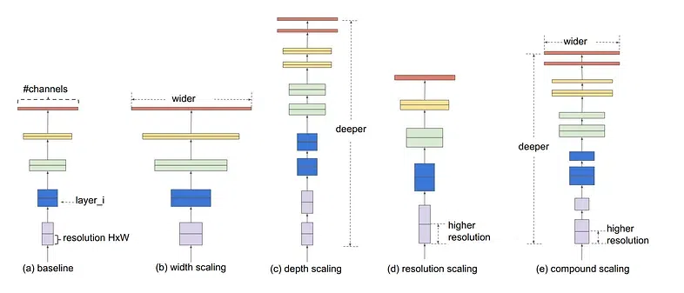
EfficientNet
The principle behind the compound scaling approach is to scale with a constant ratio in order to balance the width, depth, and resolution parameters.
Handles High-Resolution Images
Better Feature Extraction with SE Blocks
Scalability for Industrial Use
EfficientNets are generally faster to train than other large CNN models. But, when large image resolution was used to train the models (B6 or B7 models), the training was slow.

Slide 11
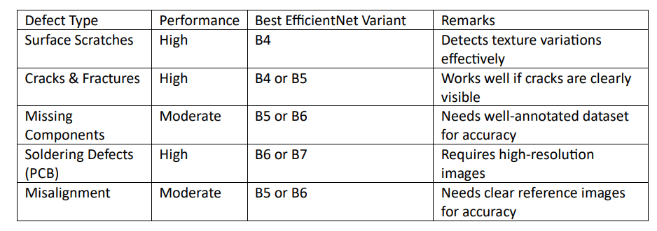
EfficientNet Performance on Key Defect Types

Slide 12
Query
What image resolution and format are typically used in defect detection?

Slide 13
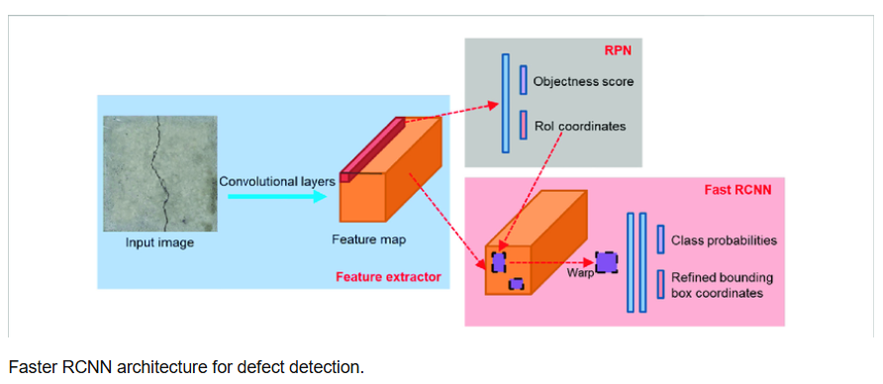
Faster RCNN
It is a two stage detector:
RPN - Propose the potential regions in the image that might contain defects.
Uses the proposed region to predict the class.
Why?
Precise Localization
High Accuracy
Confidence Score
Factors Influencing:
Hardware Requirements
Training Data

Slide 14
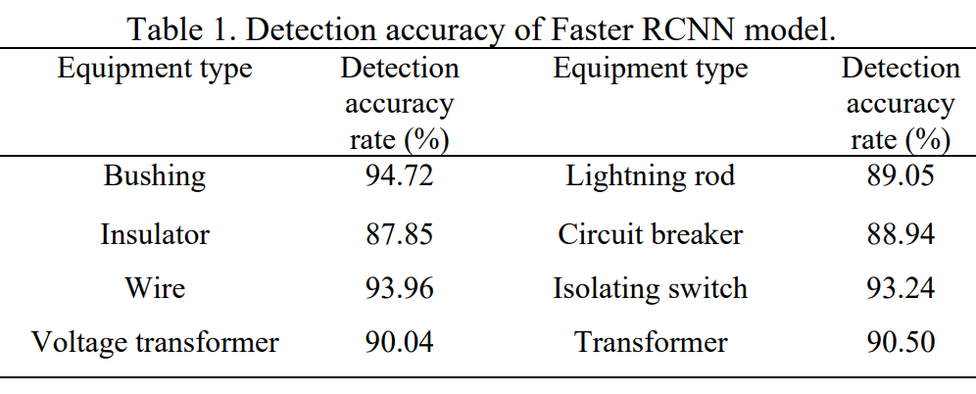
SOURCE: A Defect Detection Method Based on Faster RCNN for Power Equipment, Yang Cheng , Lingzhi Xia , Bo Yan , Jiang Chen , Dongsheng Hu , Lvfu Zhu

Slide 15
Query
How can GenAI models be used in our Project?

Slide 16
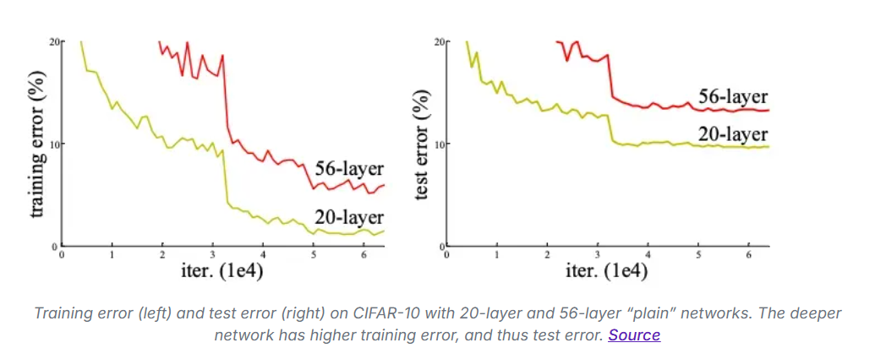
ResNet (Residual Network)
Purpose: Used in deep learning for image classification, object detection, and recognition.
Key Feature: Skip connections (shortcut paths) to avoid vanishing gradient issues.
Advantage: Enables training of very deep networks (e.g., ResNet-50, ResNet-101).

Slide 17
Essential Libraries for CNN in Jupyter Lab
NumPy – Handles image data as numerical arrays, making it easier for CNN models to process.
TensorFlow – The main deep learning framework used to build and train CNN models.
Keras (Sequential, Layers) – Provides an easy way to create CNN architectures using layers like convolution, pooling, and dense layers.
Pandas – Helps load and manage datasets, especially when working with CSV files containing image labels.
Matplotlib – Helps visualize images, training loss, and accuracy.

Slide 18
Libraries for Different CNN Models
Queries
YOLO & Faster R-CNN → Require OpenCV for real-time image processing.
ResNet & EfficientNet → Use TensorFlow/Keras for training deep classification models.
All models need NumPy (for numerical data handling) and Matplotlib (for visualization).
Based on our project requirements, which CNN model would you recommend?

